Slide 1


Code Racer
Team 3 Presents . . .
A new typing experience

Slide 2

About Code Racer
What is Code Racer?
Lets be honest, you might have a fast typing speed, but how fast can you type source code?
Normal typing tests usually measures accuracy and speed by providing users a simple paragraph to type.
When typing code, many different symbols/special characters are used frequently. If you don’t have them all memorized, it may slow you down.
We want to offer our users a fun new experience to get faster at typing code.

Slide 3

Continuing Professional Development
Web Animation (Simple 2D Graphics)
Video Game Development (Rules/Scoring System)
Password Encryption
Javascript Event Listeners
Unicode Conversion
Gave us many problems when debugging (more on this later)
Outside Topic 6
Outside Topic 7
Topics outside of the curriculum used to complete the project.

Slide 4





Skills and Tools
Skills/tools used
GitHub
WeChat
Google Drive
YouTube
Team Viewer

Slide 5


Skills and Tools cont.
Photoshop
Sublime Text

Slide 6
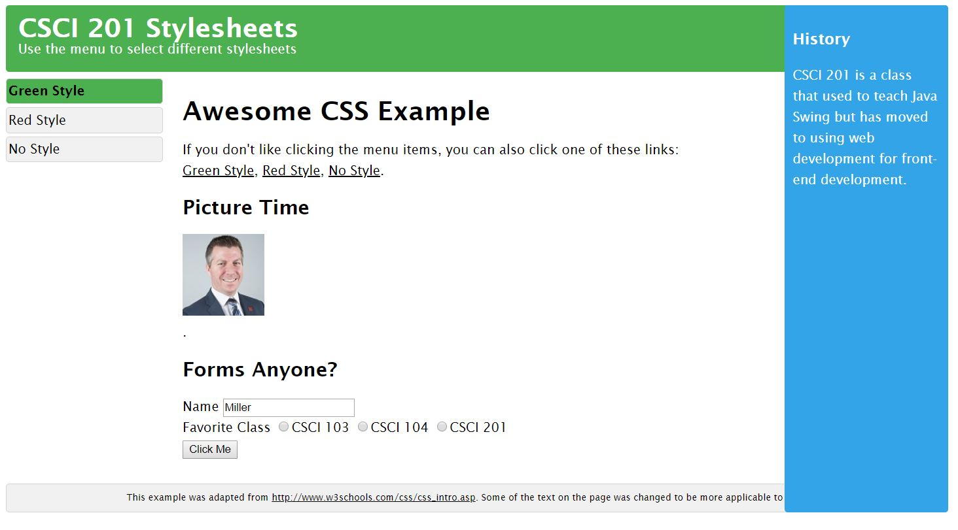
Design and Development Decisions
What worked and what didn’t with respect to project design and teamwork?

Slide 7
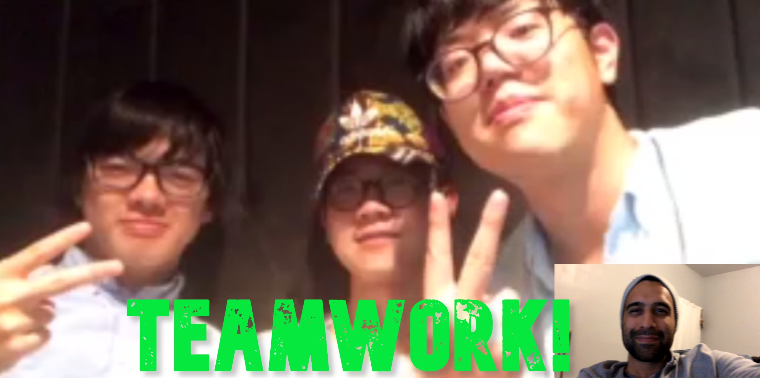
What worked?
Teamwork: what worked out very well for us is communication. Everyone participated on this project evenly.
Everyone had their own tasks to complete and if someone got stuck, we all helped to solve the problem.
Project: . . .

Slide 8
What didn’t work?
Teamwork: Meetings in person did not always work. Everyone has their own personal schedules and some of us do not live conveniently close to campus.
Sometimes it is difficult to read and understand other peoples code without being with them to explain etc.
It was challenging to design the project for where at times we didn’t have to wait on one part of the project to start another.
Project: We had plans to have a friends list and be able to challenge current logged in users to a typing race but due the limited time, we had to get rid of that functionality

Slide 9

Outside Courses
CSCI 103
Basic programming
CSCI 104
Data Structures
CSCI 170
Encryption
ENGR 102
Professional Aspects of Engineering
WRIT 340
Documentation
What other courses were used in the project?

Slide 10
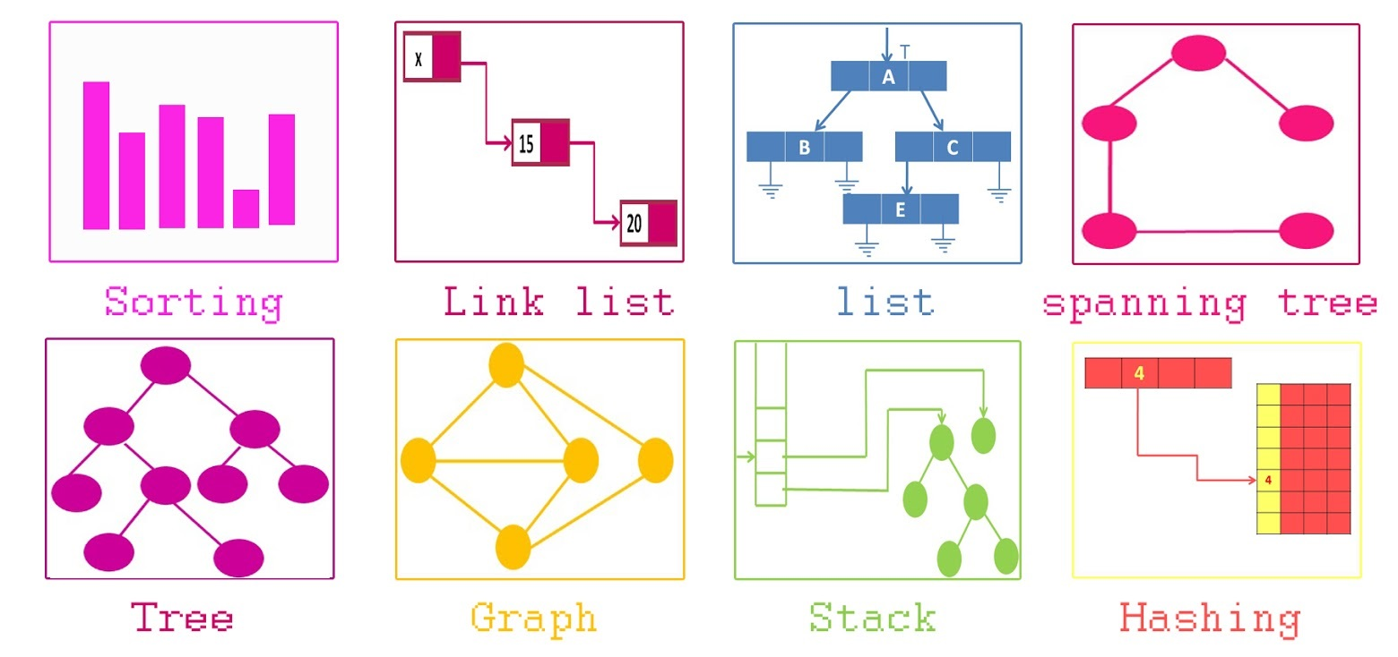
Data Structures
List
Vector of session, String, etc..
Hash table
Use hash table for encryption.
Readfile class
Create our own class to organize data
Validation
Dealing with input data from clients
MySQL
Store users’ info, score
Map
Map the key on the keyboard to some numerical value for the function to read
What data structures were used in the project?
How we organized and stored data?

Slide 11
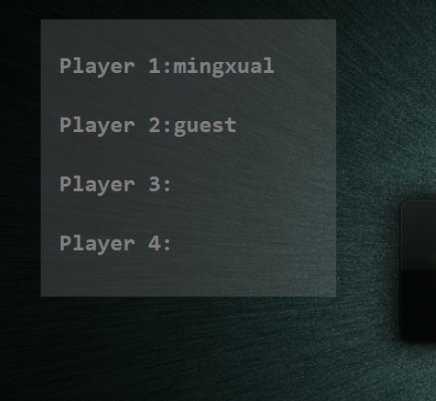
Multi-Threading
How multiple threads were used
The game page will receive the connections from different users.
We created a websocket and a server class to handle multiple sessions.
The player area will show the usernames of players currently in the game and update automatically when a new player joins, up to 4 people maximum.

Slide 12
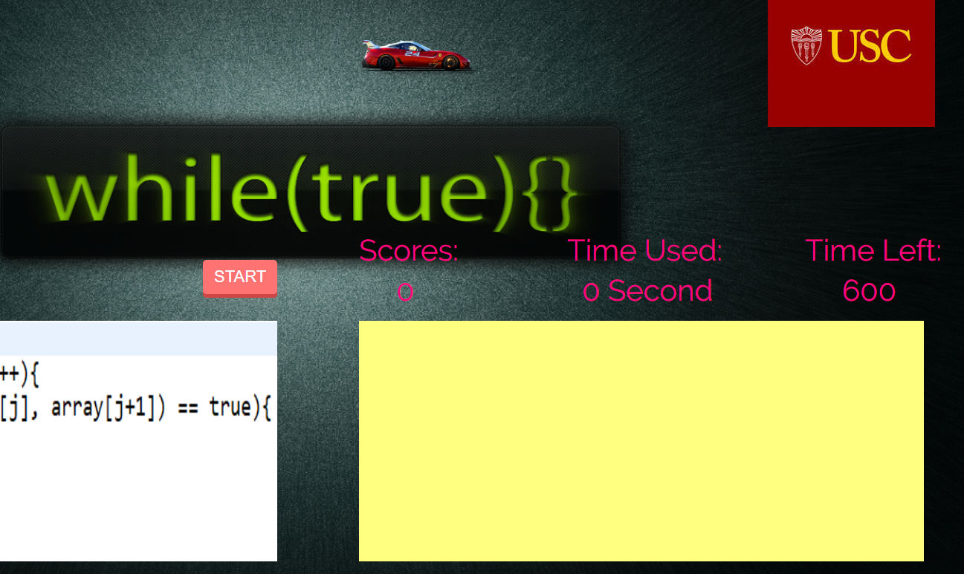
Networking
How networking was used
The first player will have the button “start” to begin the game while other players won’t have this button until the game begins.

Slide 13
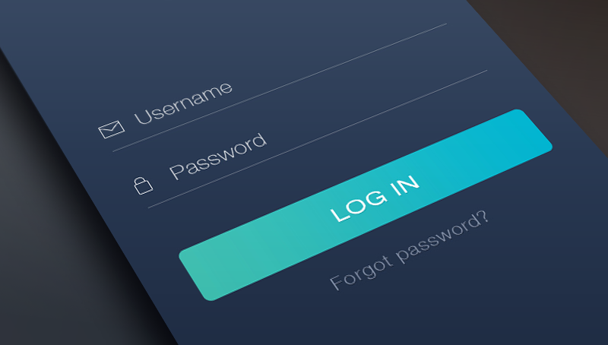
User Login Functionality
Guests Users:
Are not able to choose their own username
Are not able to store their personal best score
Are not allowed to be put on the glorious top scores hall of fame
Authenticated Users:
Have all features mentioned above
Differences for guests and authenticated users

Slide 14

Demonstration demo = new Demonstration();
demo.start();

